Slide 1


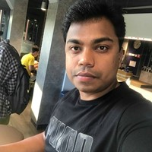


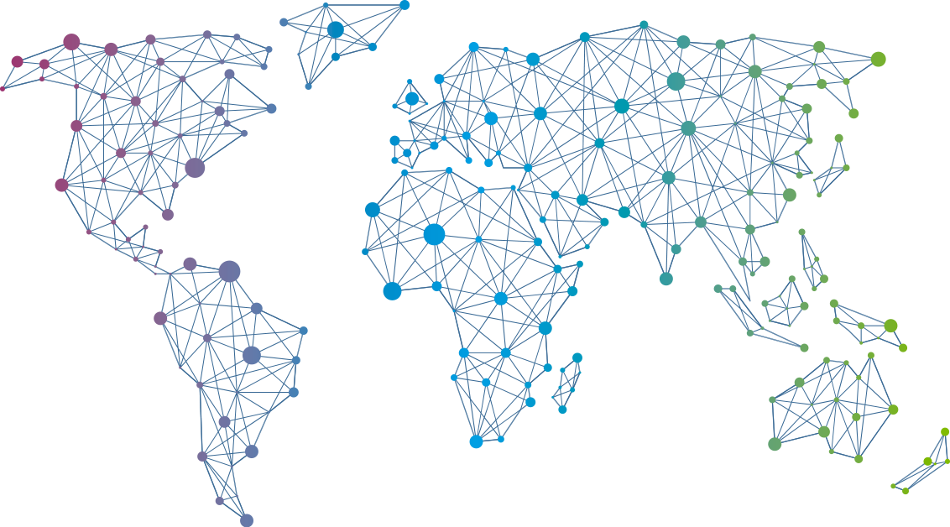

Speaker
Vignesh Ganesan
Securing your Azure Identity infrastructure
Vignesh Ganesan
cloudvignesh
September 16th & 17th
^{Online Event}
Powered By
International Conference

